Slide 1
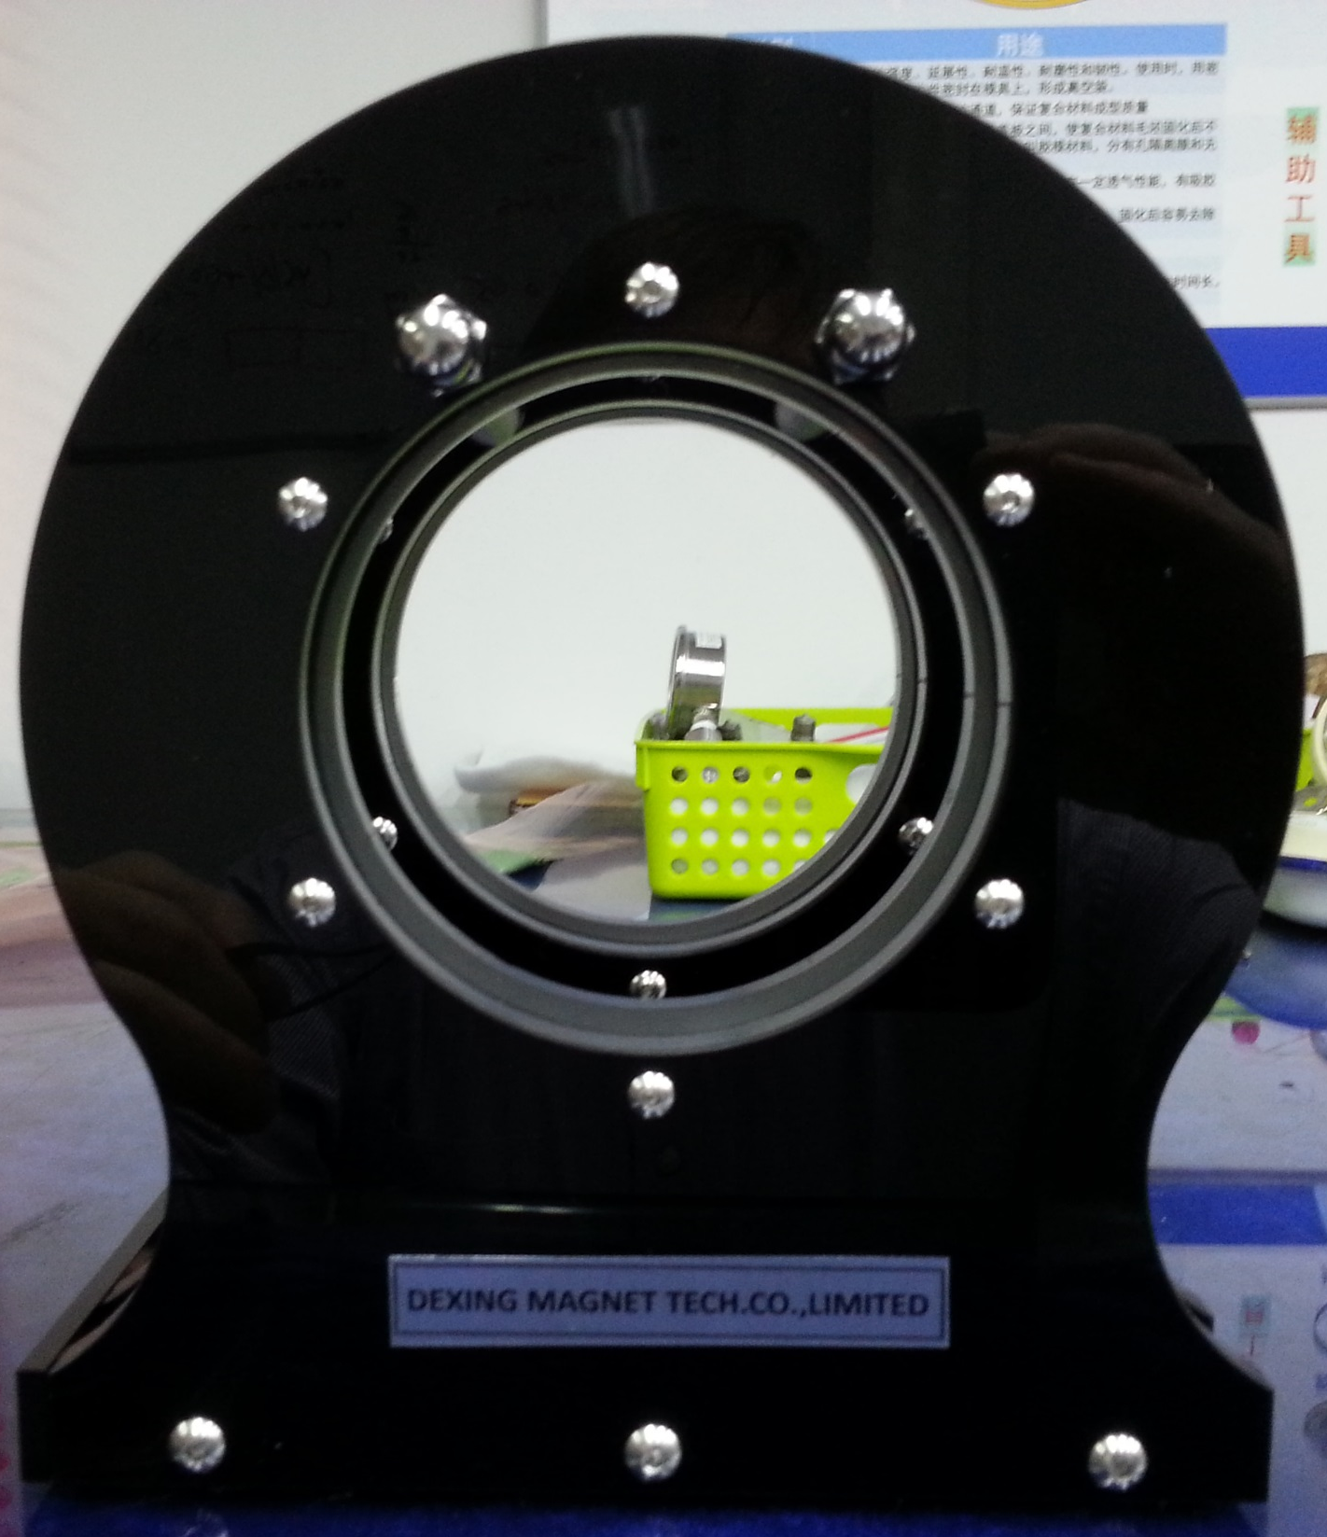
Pickup coils
Excitation coil

Slide 2
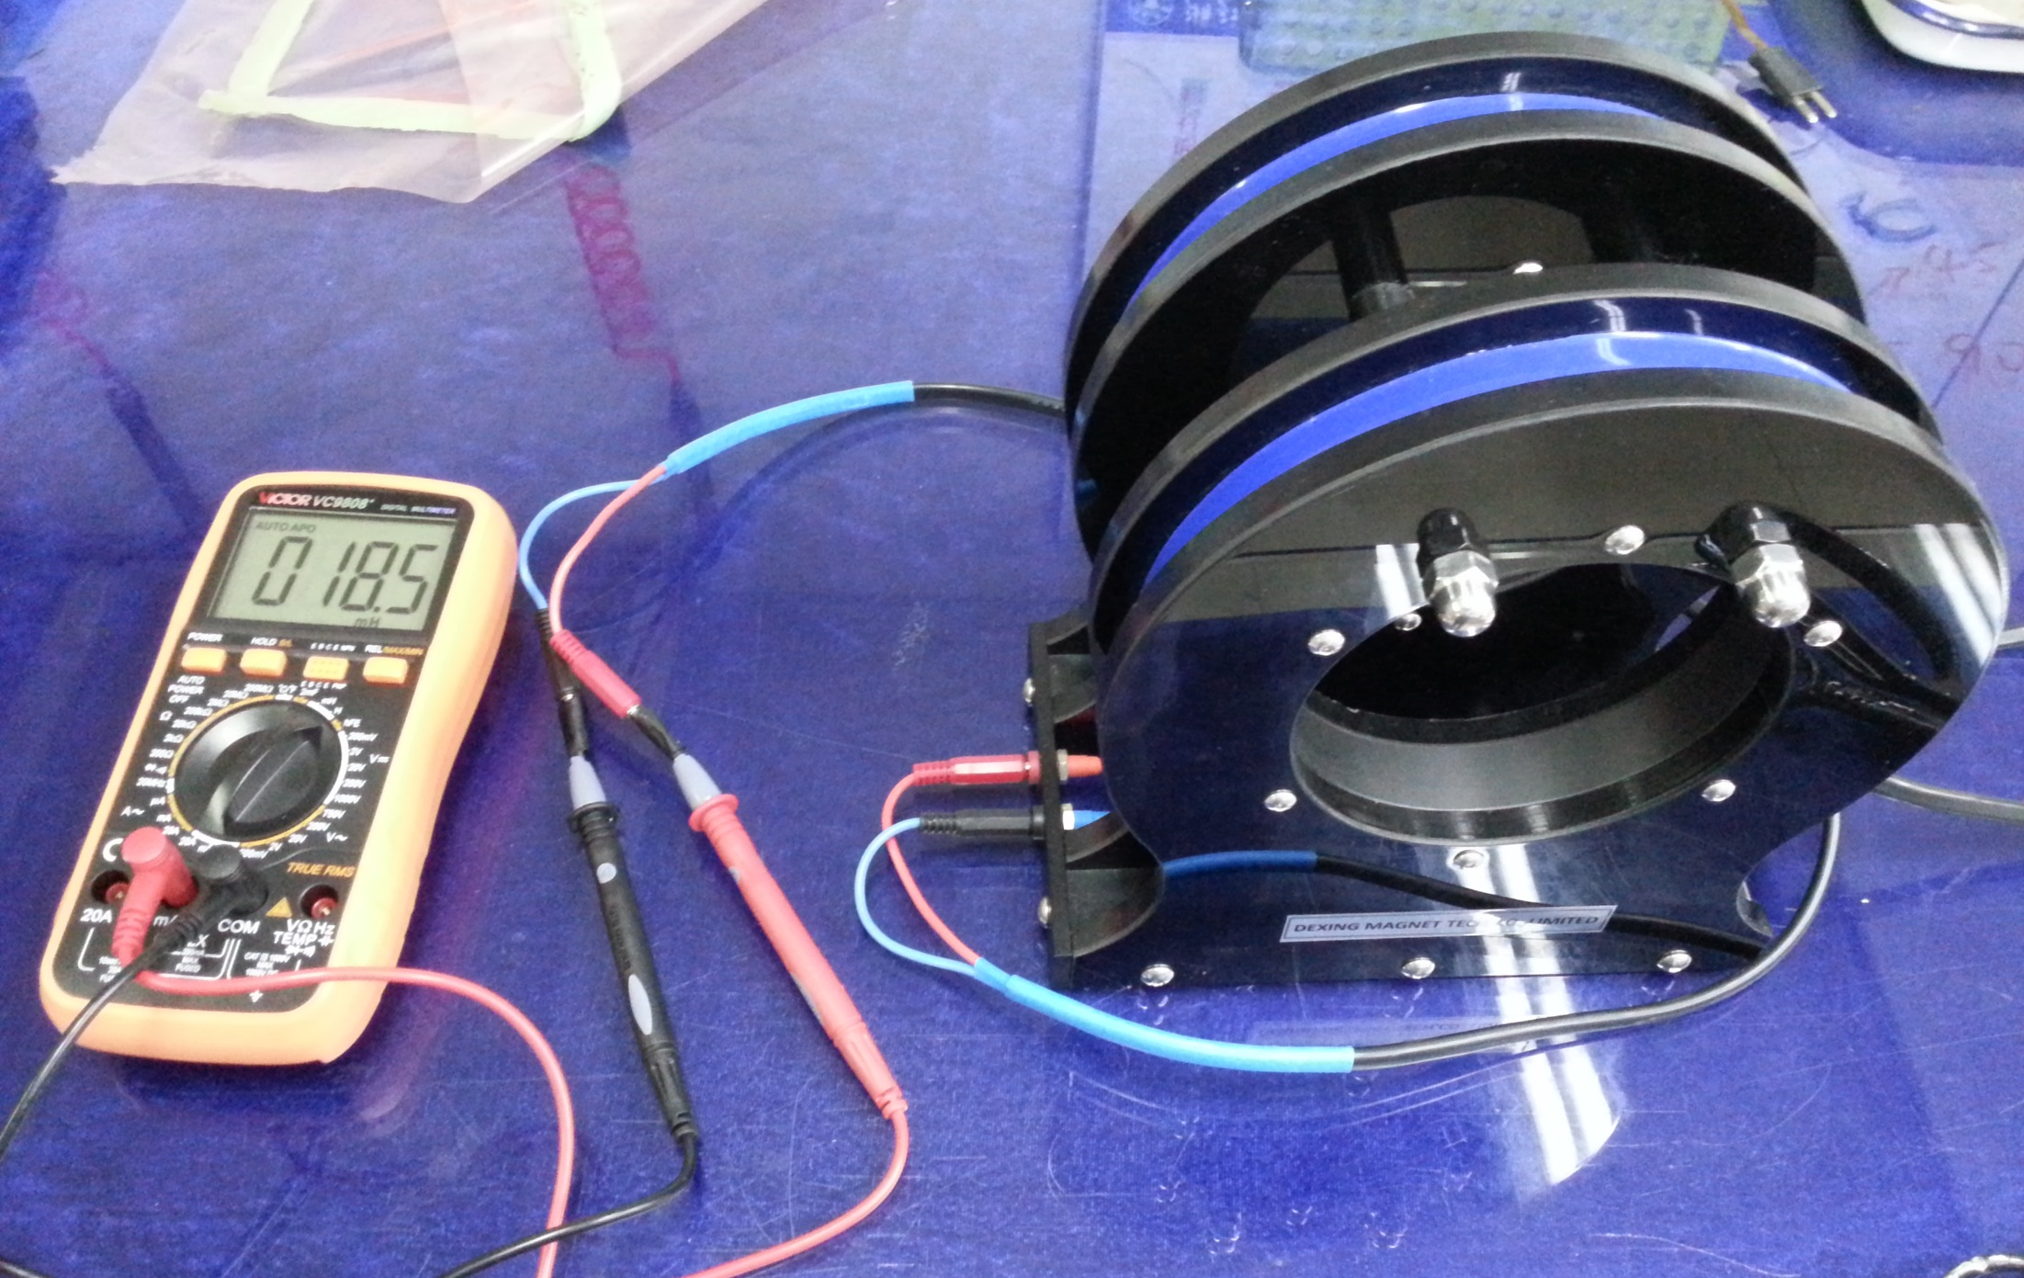
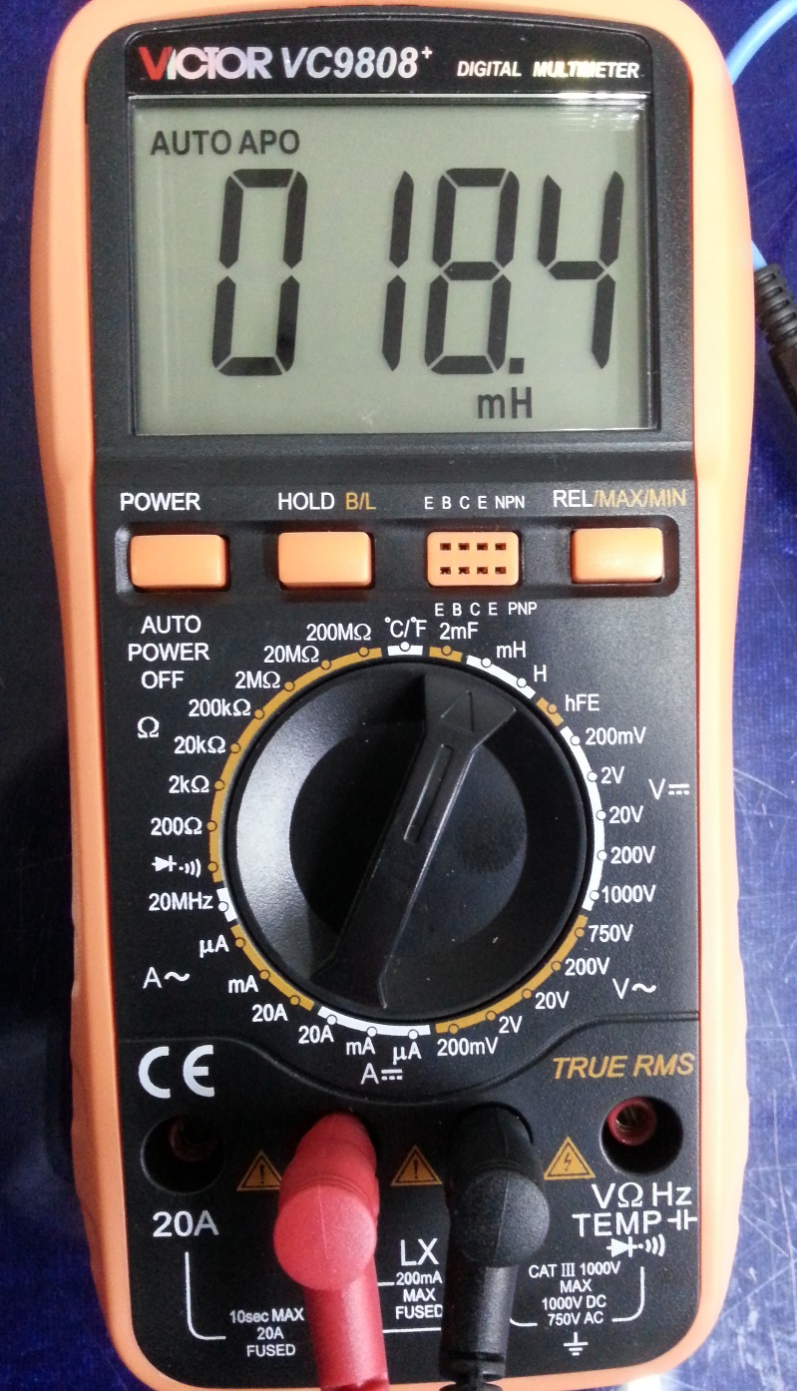

Slide 3
C

Slide 4
TS250-2
R = 0.1 Ω
(signal resistor; voltage ∼ field)
Excitation coil
Pickup coils
twisted-pair cables
NI 9215: 4 differential analog inputs (virtual ground), ±10 V, 16 Bit, 100 kS/s per channel, screw-terminals, simultaneous sampling of all input channels

